Slide 1
Project Results
Magnetospheric Multiscale Mission
Daroc Alden
Samantha Piatt
Jeremy Walker

Slide 2
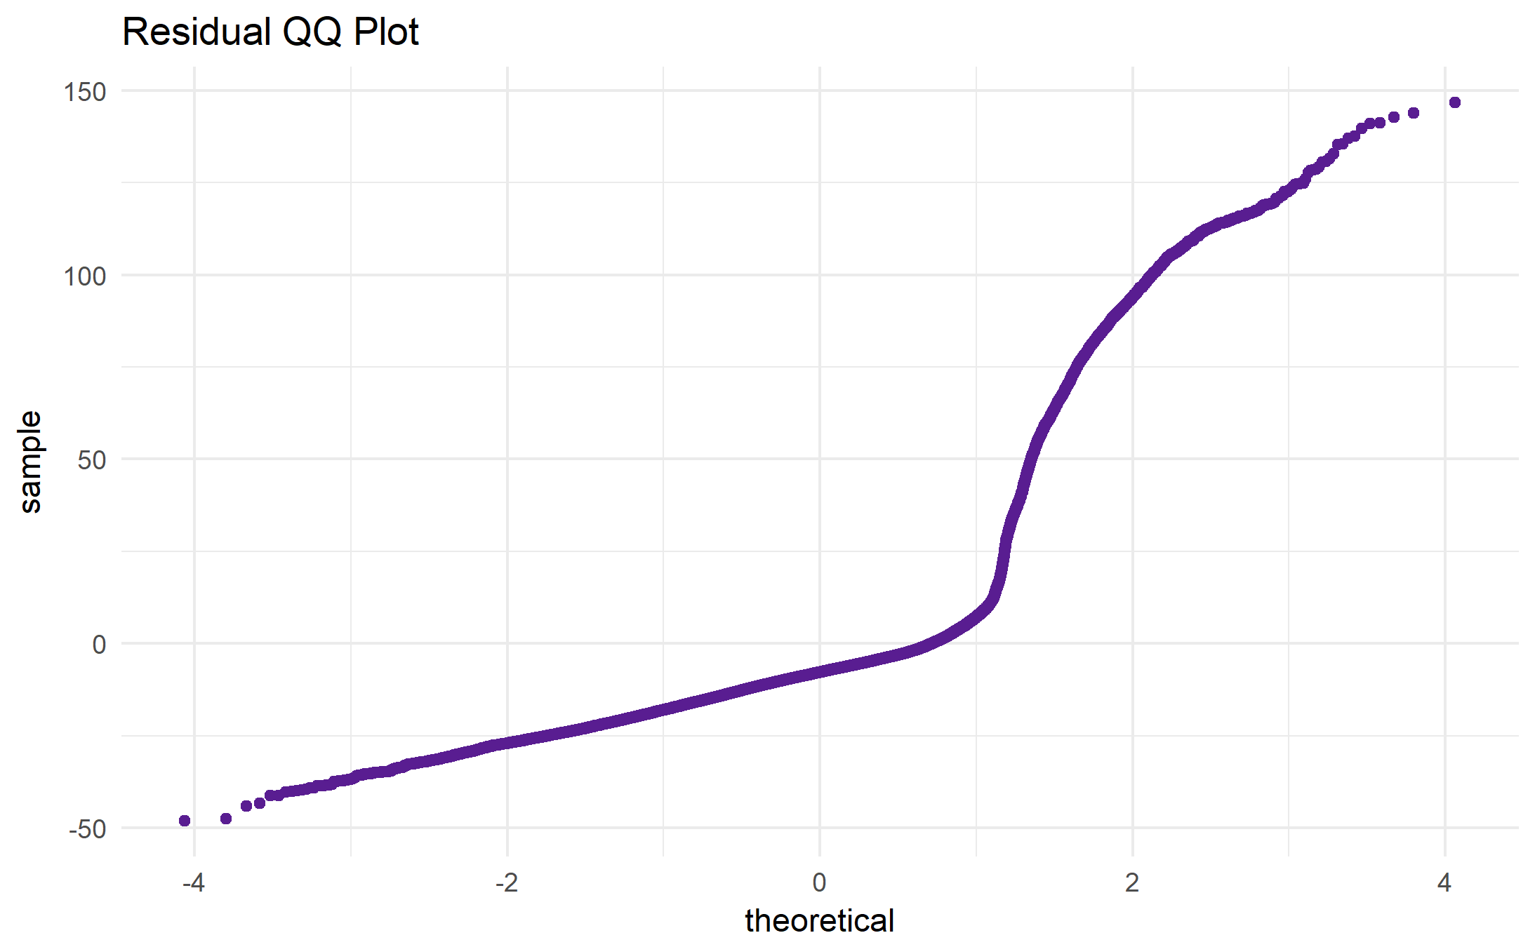
Data Exploration
We found that the data did not follow the i.i.d. assumption.
We hypothesized that we should be treating it as a Time Series.

Slide 3
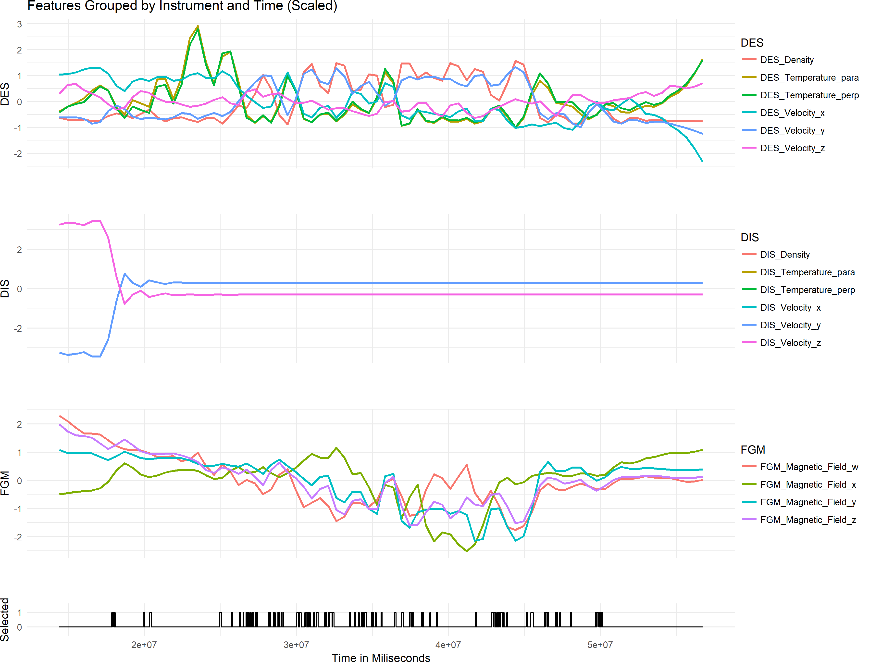
Data Exploration
We found that the DIS instrument data did not seem to greatly impact the selections, so we removed it from our models.

Slide 4
Feature Sets
Time Shift
Time Difference
 | Density.1 | Density.0 | Density.2
1 | … | 1.1023268 | 1.3588403
2 | 1.1023268 | 1.3588403 | 1.3109657
3 | 1.3588403 | 1.3109657 | 1.5180655
4 | 1.3109657 | 1.5180655 | 1.5744927
5 | 1.5180655 | 1.5744927 | …
 | Density.Past | Density | Density.Future
1 | 0.000000 | 1.1023268 | -0.3868457
2 | 0.2565135 | 1.3588403 | -0.09930529
3 | 0.08038215 | 1.3109657 | -0.11654876
4 | 0.2606879 | 1.5180655 | 0.13234722
5 | 0.25194312 | 1.5744927 | 0.00000000

Slide 5
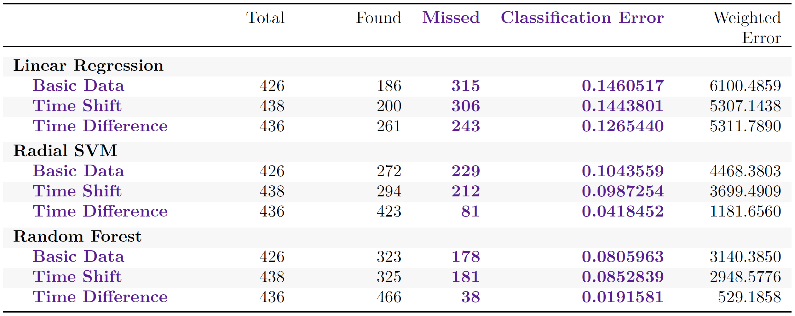
Methods

Slide 6
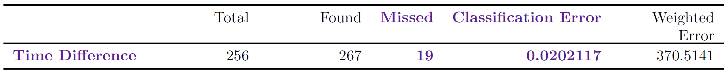
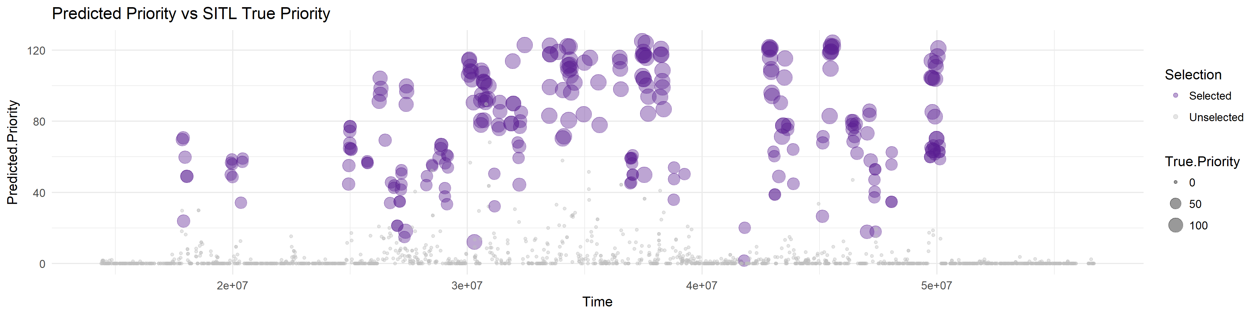
Validation

